Slide 1

House Price Prediction System
RNS INSTITUTE OF TECHNOLOGY
BENGALURU - 98
DEPARTMENT OF INFORMATION SCIENCE & ENGINEERING
Presentation on Internship
Candidate Name:YUKTHA M
USN: 1RN18IS126
Candidate Name:VARUN D S
USN: 1RN18IS120
New Age Solutions Technologies
Internal Guide
Mr. Santosh Kumar S K
Prof./Asst., Dept of ISE, RNSIT
External Guide
Mr. Deepak Garg
Founder, NASTECH, Bangalore

Slide 2
AGENDA
Abstract
About the Company
Introduction
Literature Survey
Requirements
System Design
Implementation
Testing
Conclusion and Future Enhancements
References
Q & A

Slide 3
ABSTRACT
House price prediction project focuses on forecasting the coherent house prices for non-house holders based on their financial provisions and their aspirations.
By analyzing the foregoing merchandise, fare ranges and also forewarns developments, speculated prices will be estimated.
The motive of this project is to help the seller to estimate the selling cost of a house perfectly and to help people to predict the exact time slap to accumulate a house.
Some of the related factors that impact the cost were also taken into considerations such as physical conditions, concept and location etc.

Slide 4
About the Company
NASTECH is formed with the purpose of bridging the gap between Academia and Industry.
NASTECH is one of the leading Global Certification and Training service providers for technical and management programs for educational institutions.
They collaborate with educational institutes to understand their requirements and form a strategy in consultation with all stakeholders to fulfill those by skilling, reskilling and upskilling the students and faculties on new age skills and technologies.

Slide 5
INTRODUCTION
House price prediction project focuses on forecasting the coherent house prices for non-house holders based on their financial provisions and their aspirations
House price prediction on a data set has been done by using Keras regression technique.
Moreover, this project can be considered as a further step towards more evidence-based decision making for the benefit of these stakeholders.
The aim of our project is to build a predictive model for change in house prices based on certain time and geography dependent variables.

Slide 6
LITERATURE SURVEY
A manual method is currently used in the market to predict the house price. The problem with this is that it doesn’t predict future prices of the houses mentioned by the customer. Due to this, the risk in investment in an apartment or an area increases considerably.
To minimize this error, customers tend to hire an agent which again increases the cost of the process.
Moreover, there is a chance that the agent might predict wrong estates and thus lead to loss of the customer’s investments. This leads to the modification and development of the existing system.
To eliminate the drawback of manual method, Machine learning algorithms can be used to help investors to invest in an appropriate estate according to their mentioned requirements. Also, the new system will be cost and time efficient. This will have simple operations.
The proposed system works on Keras Regression Algorithm.

Slide 7
Requirements
Hardware Requirements
- Processor: Pentium IV or above
- RAM: GB or more
- Hard Disk: 2GB or more
Software Requirements
- Operating System: Windows 7 or above
- IDE: Google Colab
Tools/Languages/Platforms
- Python

Slide 8
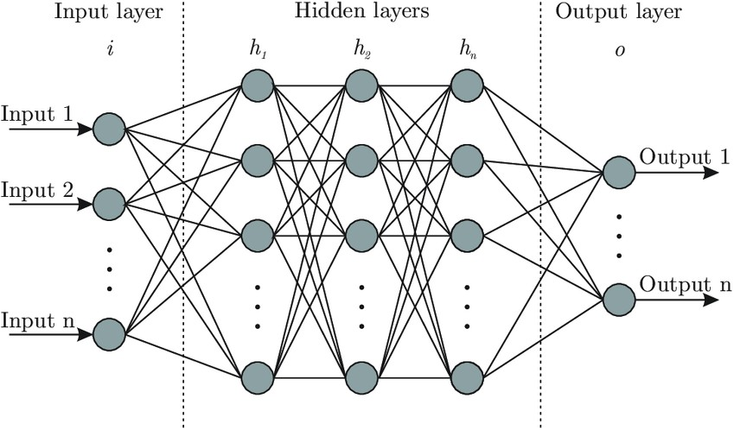
System Design
Keras Neural network has been used in the project which is a fast, open-source, and easy- to-use Neural Network Library written in Python.
Since there are 19 features, 19 neurons are inserted as a start, 4 hidden layers and 1 output layer due to predict house Price.

Slide 9
Keras
Basic Steps involved in Keras Regression:
Step 1
Split the dataset to training and test data
Step 2
Build and train Neural Network
Step 3
Find mean squared error (MSE)which is also called loss function.
The mean square error is the average of the square of the difference between the observed and predicted values of a variable.
Step 4
Find Root Mean Squared Error

Slide 10
Coding
Evaluation on Test Data
y_pred = model.predict(X_test) from sklearn import metric
sprint ('MAE:', metrics.mean_absolute_error(y_test, y_pred)) print('MSE:', metrics.mean_squared_error(y_test, y_pred)) print('RMSE:', np.sqrt(metrics.mean_squared_error(y_test,y_pred))) print('VarScore:',metrics.explained_variance_score(y_test,y_pred))
Visualizing Our predictions
fig = plt.figure(figsize=(10,5)) plt.scatter(y_test,y_pred)
Perfect predictions
plt.plot(y_test,y_test,'r')

Slide 11
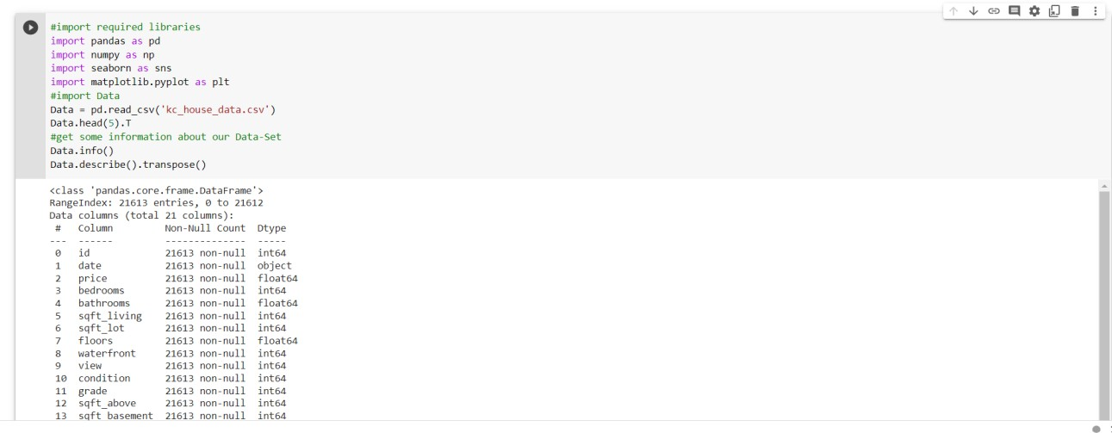
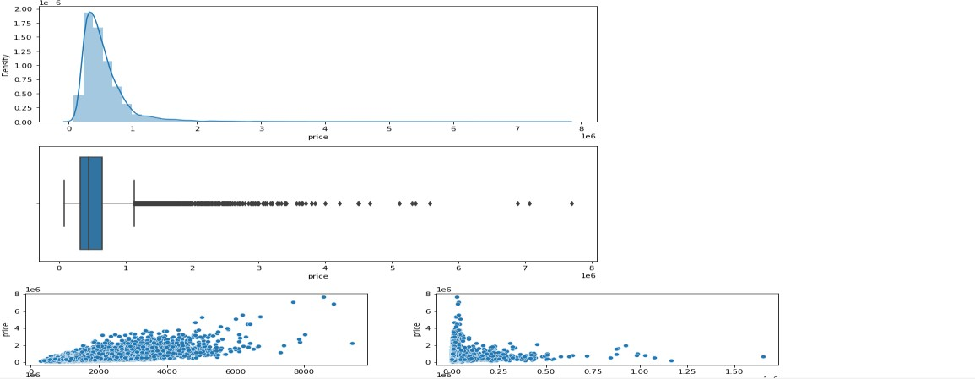
Implementation
Reading CSV File
Visualizing house price

Slide 12
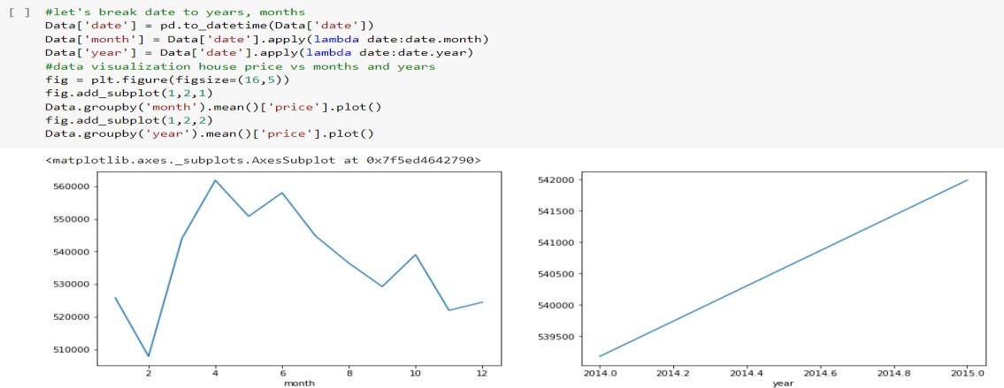
Implementation
Price range month vs year

Slide 13
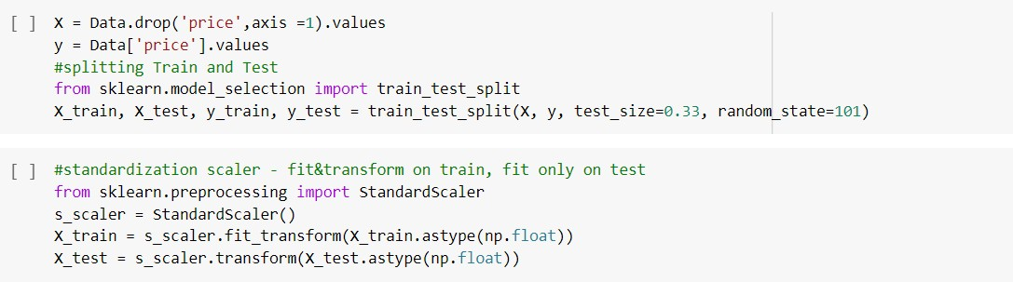
Implementation
Dataset Preparation

Slide 14
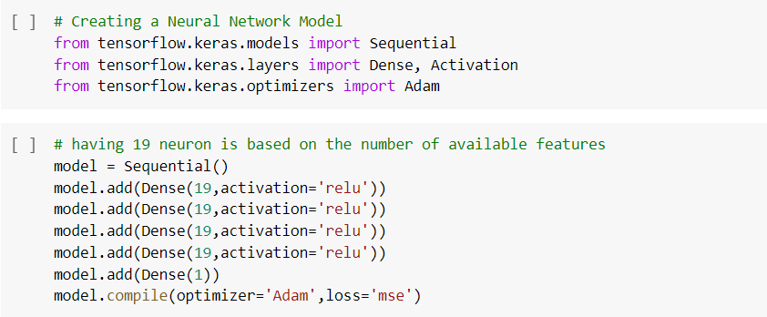
Implementation
Keras Implementation

Slide 15
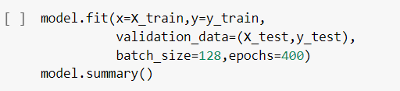
Implementation
Validating Accuracy

Slide 16
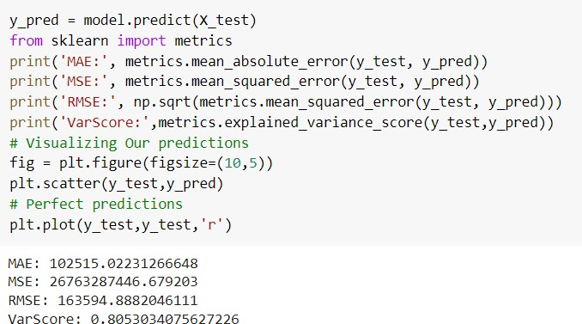
RESULTS
We are calculating mean absolute error, mean square error and variable score to check the accuracy of this algorithm.
It is clearly seen that this approach is 81% accurate.

Slide 17
Conclusion
The proposed model is definitely the best substitute for the manual method wherein third party is involved and is potentially vulnerable along with being not so pocket friendly.
Based on the results, it can be concluded that such ML-driven predictions are easily comprehendible and significant from a data-analytics point of view.
When correctly implemented, a high rate of accuracy can be achieved.

Slide 18
Future Enhancements
To make the system even more informative and user-friendly, Gmap can be included. This will show the neighborhood amenities such as hospitals, schools surrounding a region of 1 km from the given location. This can also be included in making predictions since the presence of such factors increases the valuation of real estate property.
Various other machine learning algorithms can also be used apart from Keras to improve the accuracy of the model.

Slide 19
REFERENCES
A. S. Temür, M. Akgün, and G. Temür, “Predicting Housing Sales in Turkey Using Arima, Lstm and Hybrid Models,” J. Bus. Econ. Manag., vol. 20, no. 5, pp. 920–938, 2019, doi: 10.3846/jbem.2019.10190.
Fan C, Cui Z, Zhong X. House Prices Prediction with Machine Learning Algorithms. Proceedings of the 2018 10th International Conference on Machine Learning and Computing ICMLC 2018. doi:10.1145/3195106.3195133.
A. Varma, A. Sarma, S. Doshi and R. Nair, "House Price Prediction Using Machine Learning and Neural Networks," 2018 Second International Conference on Inventive Communication and Computational Technologies (ICICCT), 2018, pp. 1936-1939, doi: 10.1109/ICICCT.2018.8473231.
Thamarai, M. & Malarvizhi, S. (2020). House Price Prediction Modeling Using Machine Learning. International Journal of Information Engineering and Electronic Business. 12. 15-20. 10.5815/ijieeb.2020.02.03.
House Price Prediction Using Machine Learning Algorithms Soft Computing Systems, 2018, Volume 837 ISBN : 978-981-13-1935-8 Naalla Vineeth, Maturi Ayyappa, B.Bharathi

Slide 20
Question and Answer

Slide 21
THANK YOU

